Slide 1
Notes:
Welcome

Slide 2
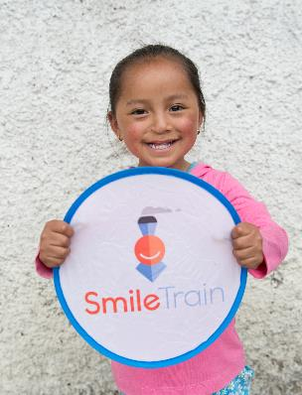
What is are Smile Train?
Smile Train is an international children’s charity that empowers local medical professional with training, funding and resources to provide free cleft surgery and comprehensive cleft care to children globally.
Notes:
What is Smile Train?
Smile Train is an international children’s charity that empowers local medical professional with training, funding and resources to provide free cleft surgery and comprehensive cleft care to children globally.

Slide 3
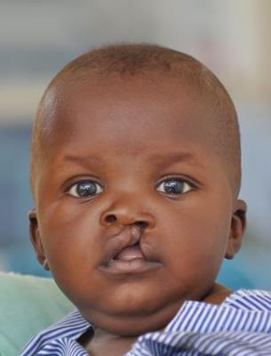
What is cleft lip and/or palate?
A cleft lip and/or palate happens early during pregnancy and develops when body parts do not fuse together properly.
This results in a hole in your lip and/or roof of the mouth
It is unknown what causes cleft lip and/or palate, but experts agree that cause of cleft involves many factors
Notes:
What is cleft lip and/or palate?
A cleft occurs when body parts do not fuse together during pregnancy, resulting in a hole in your lip and/or roof of the mouth.
It is unknown what causes a cleft lip and/or palate; however, most experts agree that the causes of cleft involve many factorsand may include: lack of nutrition and Vitamin B, genes inherited from a child’s parents, etc.

Slide 4
Living with cleft lip and/or palate
Globally, 1 in every 700 babies are born with a cleft lip and/or palate
Children with clefts often have difficulty eating, breathing, speaking and ultimately thriving
Many families around the world do not have access to free cleft care and cannot afford the cost of cleft surgery
Notes:
Living with cleft lip and/or palate
Globally, 1 in every 700 babies are born with a cleft lip/and or palate and 200,000+ babies are born with clefts every year globally.
Children with clefts often have difficulty eating, breathing, speaking and ultimately thriving.
Unfortunately, many families around the world do not have access to free cleft care and cannot afford the cost of cleft surgery.

Slide 5
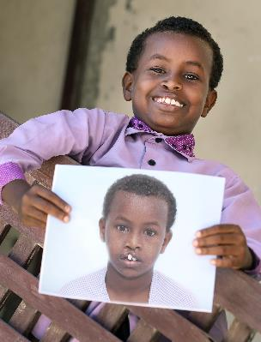
How Smile Train help
Funding from Smile Train allows our local partner hospitals to provide free cleft treatment year round
Cleft surgery can take as little as 45 minutes and can cost as little as £150
Surgery has come a long way and today, the surgery is safe and the transformation is immediate
Notes:
How Smile Train help
The funding that Smile Train provides to its local medical professionals, allows our partners to work year round in their own communities to provide free cleft surgery and comprehensive cleft care to children globally.
Cleft surgery can take as little as 45 minutes and can cost as little as £150. Surgery has come a long way and today the procedure is safe and the transformation is immediate.

Slide 6
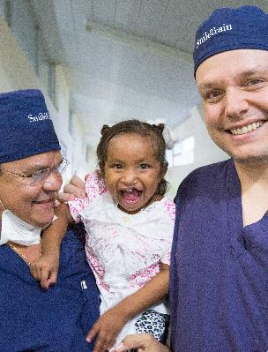
Additional services
After surgery children often need dental and orthodontic treatment, as well as speech therapy
Smile Train also provides funding to local partner hospitals so that they can purchase medical equipment
Help to educate the public by raising awareness and launching outreach programmes
Notes:
Smile Train and further care
After cleft surgery, children often need further care, known as comprehensive cleft care which includes dental and orthodontic treatment, psychosocial services, and speech therapy. Smile Train currently supports comprehensive cleft care programmes in more than 25 countries.
Smile Train also provides funding to local partner hospitals, so that they can purchase medical equipment. This allows more cleft patients to receive safe surgery.
In addition, they help to educate the public by raising awareness about the issue of cleft, as well as launching outreach programmes to help children with cleft in remote areas. This is done through the use of radio, newspapers, fliers and much more.

Slide 7
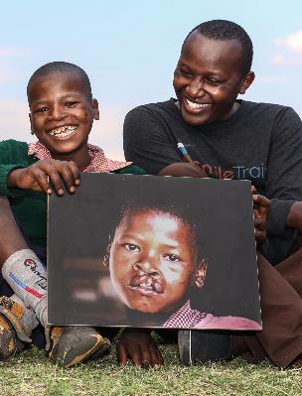
How supporting Smile Train helps
Donations from supporters help to provide funding for training and resources to local hospitals around the world.
This allows our 2,100+ cleft medical professionals and 1,100+ partner hospitals provide free cleft treatment to children in need.
Notes:
How supporting Smile Train helps
Donations to Smile Train help to provide funding for training and resources to local hospitals around the world so that they can provide free cleft surgery and comprehensive cleft care to children in need.
By supporting Smile Train, you are helping more than 2,100 cleft medical professionals and more than 1,100 hospitals around the world provide free cleft treatment to those in need.

Slide 8
Thank you for helping to change the world one smile at a time!
Notes:
Thank you for helping to change the world one smile at a time!

