Slide 1
Notes:
Welcome

Slide 2
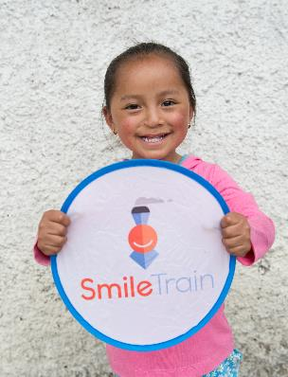
What is Smile Train?
Smile Train is a global children’s charity that empowers local medical professional with training, funding and resources to provide free cleft surgery and comprehensive cleft care to children globally
Notes:
What is Smile Train?
Smile Train is a global children’s charity that empowers local medical professional with training, funding and resources to provide free cleft surgery and comprehensive cleft care to children globally.

Slide 3
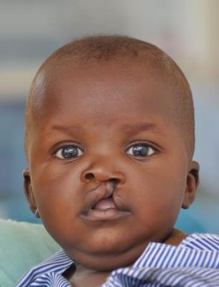
What is cleft lip and/or palate?
A cleft lip and/or palate happens when parts of your body do not join together during pregnancy
It can involve the lip and/or the roof of the mouth.
People do not know why this happens, but research is ongoing to find out more.
Notes:
What is cleft lip and/or palate?
A cleft happens when body parts do not join together during pregnancy, creating a hole in your lip and/or roof of the mouth.
People do not know why this happens but research is ongoing to learn more.

Slide 4
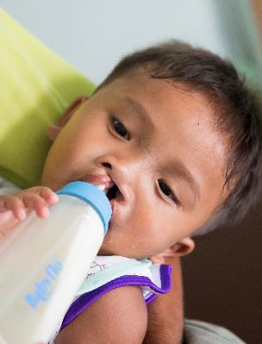
Living with cleft lip and/or palate
Globally, 1 in every 700 babies are born with a cleft lip and/or palate
It can cause trouble with eating, breathing and speaking
Many families around the world do not have access to free cleft care and cannot afford the cost of cleft surgery
Notes:
Living with cleft lip and/or palate
Globally, 1 in every 700 babies are born with a cleft lip/and or palate and 200,000+ babies are born with clefts every year globally.
Children with clefts often have trouble eating, breathing and speaking.
Unfortunately, many families around the world do not have access to free cleft care and cannot afford the cost of cleft surgery.

Slide 5
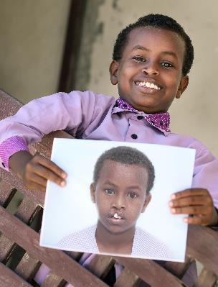
How Smile Train help
Funding from Smile Train allows our partners to work year round to provide free cleft treatment
Cleft surgery can take as little as 45 minutes and can cost as little as £150
The treatment is safe and the change is immediate
Notes:
How Smile Train help
The funding that Smile Train provides its local medical professionals, allows our partners to work year round in their own communities to provide free cleft surgery and comprehensive cleft care to children globally.
Cleft surgery can take as little as 45 minutes and can cost as little as £150. The surgery is safe and the change is immediate.

Slide 6
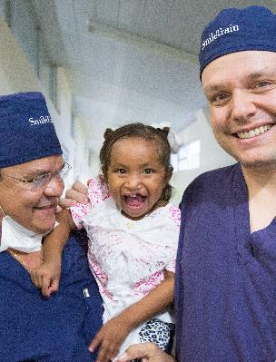
Smile Train and further care
After cleft surgery children may also need additional help such as dental care and speech therapy
Smile Train also provide funds to local partner hospitals so they can purchase medical equipment
Smile Train also help educated people about cleft and help learn about cleft and find children with clefts
Notes:
Smile Train and further care
After cleft surgery, children often need more help such as dental care and speech therapy. Smile Train currently supports comprehensive cleft care programmes in more than 25 countries.
Smile Train also provides funding to local partner hospitals, so that they can purchase medical equipment. This allows more cleft patients to receive safe surgery.
In addition, they help to educate people about cleft and create programmes to help find children with clefts in the community by using radio, newspapers and much more.

Slide 7
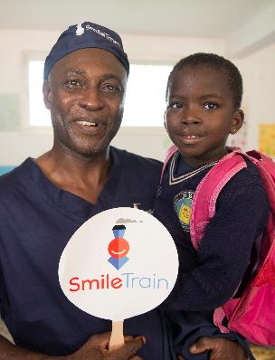
How supporting Smile Train helps
By supporting Smile Train you are helping 2,100+ cleft medical professionals and 1,100+ hospitals around the world provide free cleft treatment to those in need.
Notes:
How supporting Smile Train helps
By supporting Smile Train you are helping more than 2,100 cleft medical professionals and more than 1,100 hospitals around the world provide free cleft treatment to those in need.

Slide 8
Thank you for helping to change the world one smile at a time!
Notes:
Thank you for helping to change the world one smile at a time!

